Slide 2
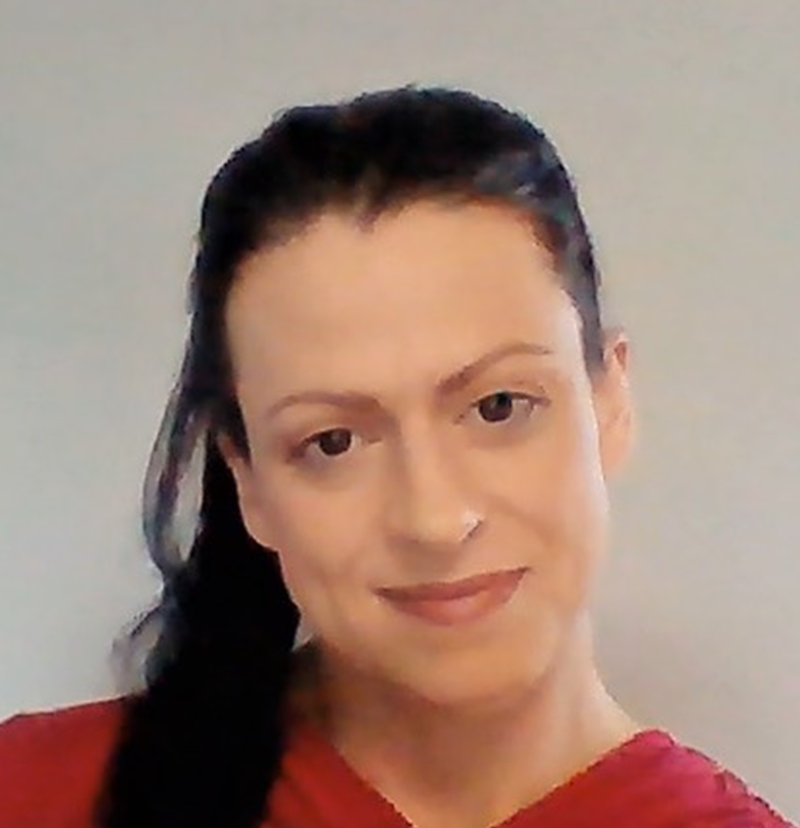
Getting Started with Microsoft Learn
Sat, May 28th
In Person event
Gemma Robson
Future-Ready Skills Lead for Microsoft UK
Notes:
Hi, I’m Gemma Robson. Future-Ready Skills Lead for Microsoft in the UK.
I’m here today to help you get started with our Microsoft Learn Platform!

Slide 3
The Agenda
Microsoft Learn Platform
Microsoft Certifications
Free Training & Exams
Notes:
I only have a short time so I’ll be whizzing through this content but I will be here the rest of the day so please feel free to come over and say hello and ask questions you may have… so I’m quickly going to
* Introduce you to the Microsoft Learn Platform
* Talk about the Power of Microsoft Certifications
Show you how you can get access to free Microsoft training and exams to kick start your career

Slide 4
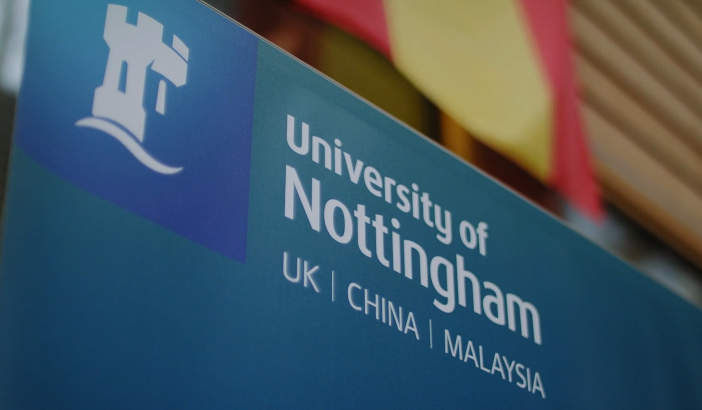
University of Nottingham Students
Notes:
But before I jump into the Microsoft Learn platform and all the fantastic learning opportunities it has to offer.. I thought you should hear what other students say have to say about it first…

Slide 5
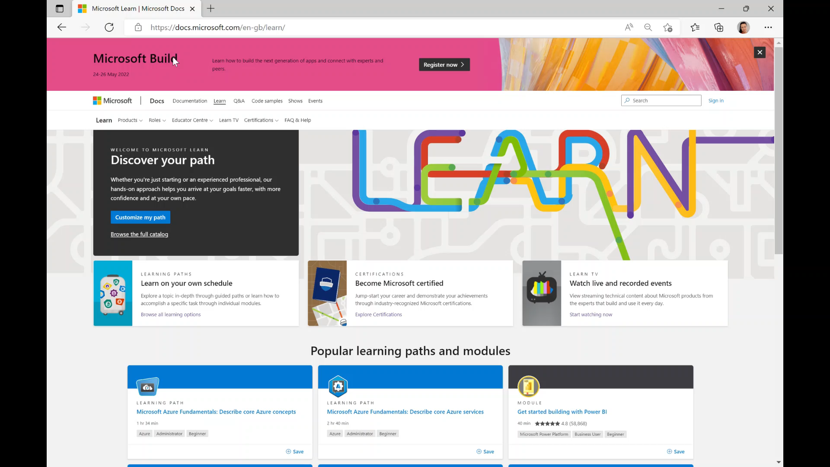
Microsoft Learn
https://docs.microsoft.com/en-us/learn/
Notes:
So you may or may have come across Microsoft Learn Platform… so I’ll give you a quick run through
This is how you find it Its absolutely free to access- just log in with your personal email address and away you go..
The platform is organised in a way which makes it super easy to navigate and find everything you need in just a couple of clicks.
You can either search for a particular certification (if you know exactly what you are interested in) for example the AI-900- or simply search a topic area to find the content you are looking for example Power Platform. You can even search by job role for example ‘’ and it will make suggestions for you.
You can choose content to supplement your learning or you can choose to cover learning paths that prepare you to take an exam to gain an industry recognised certification.
The best thing about Learn is the varied & vibrant content and the way its nicely organised into
learning paths- modules and units- bitesize sections that you can dip into whenever it suits you
and revisit at a later date- it even tells you how long each section will take to help you gauge
how much time you will need to set aside.
5. Its so versatile- you can just log in and it remembers what you have already covered and keeps
track of your progress
With a mix of short text pages, videos, real life examples and hands on labs so its very
experiential and makes learning much more fun and interesting and we often find that students who use learn return to complete more and more material and pass many certifications. I’m a prime example of that! This time last year I was a student and I passed the AI-900 last May and went on to pass a further 4 certifications last June alone… I didn’t realise at the time but that achievement played a huge part in how I was hired by Microsoft for this role!

Slide 6

Personal benefits: Be the tech pro you want to be
Earning certifications can lead to a variety of personal benefits
84%
61%
76%
91%
Get a boost in determination to succeed professionally
Obtain the specific IT job roles they wanted
Achieve greater satisfaction in their jobs
Feel increased confidence
Notes:
So why choose to pass a certification using Microsoft Learn? Why bother?
Because students who achieve Microsoft certifications…..

Slide 7
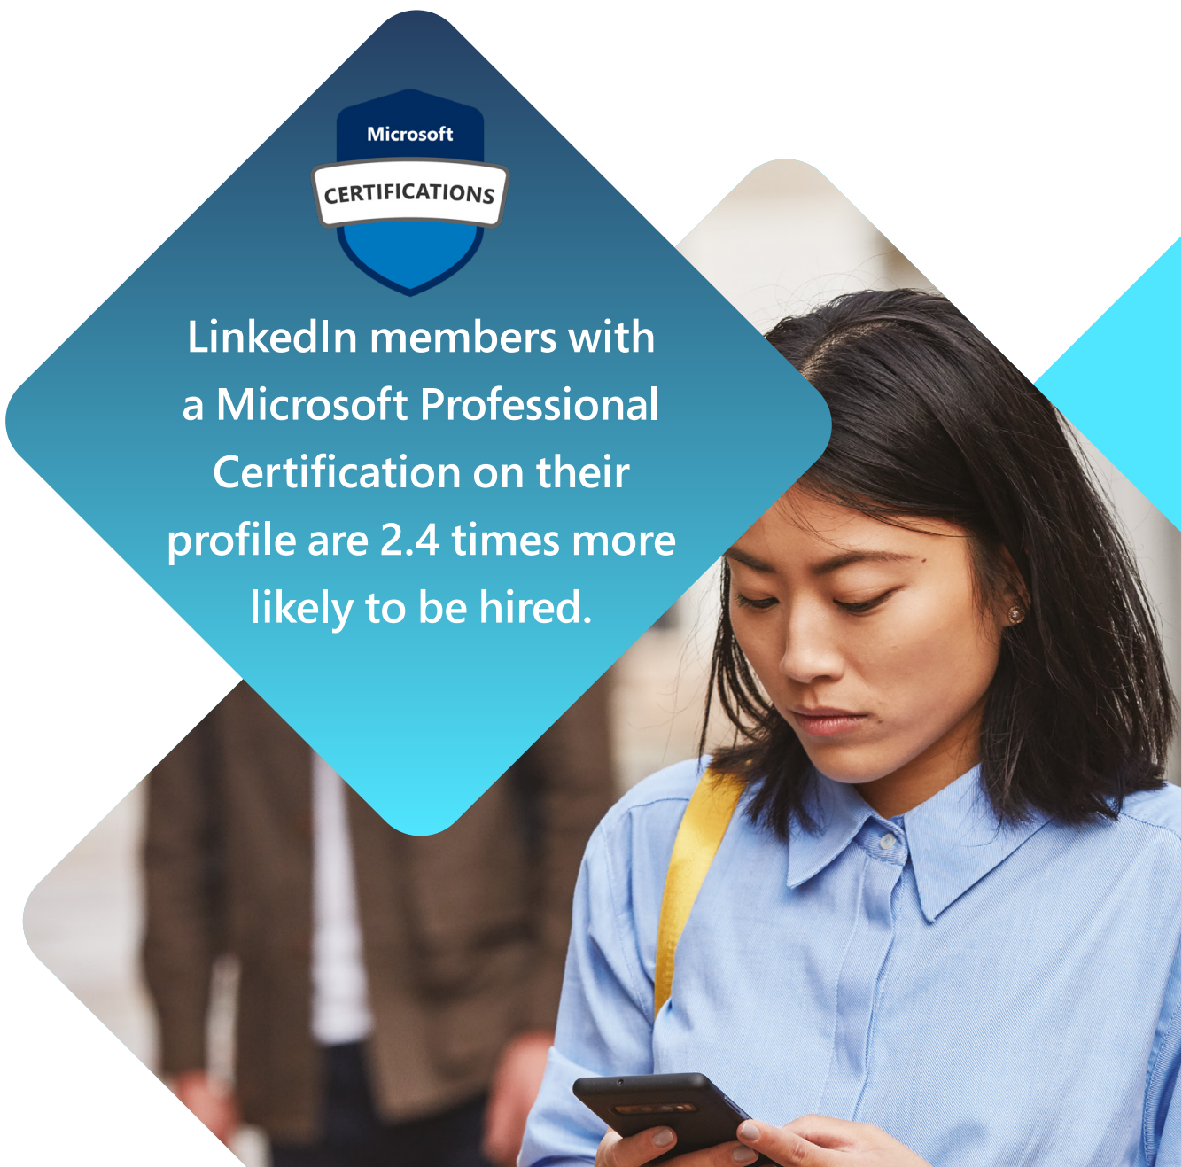
Increased Employability
Abbey's story
Notes:
And this is the biggie…
Student who pass a Microsoft Certification and post their electronic badge on linked in are 2.4 times more likely to gain employment! And not many students know about this so get in there first and stand out above the rest!... Interested?... Lets hear Abbey’s story..

Slide 8
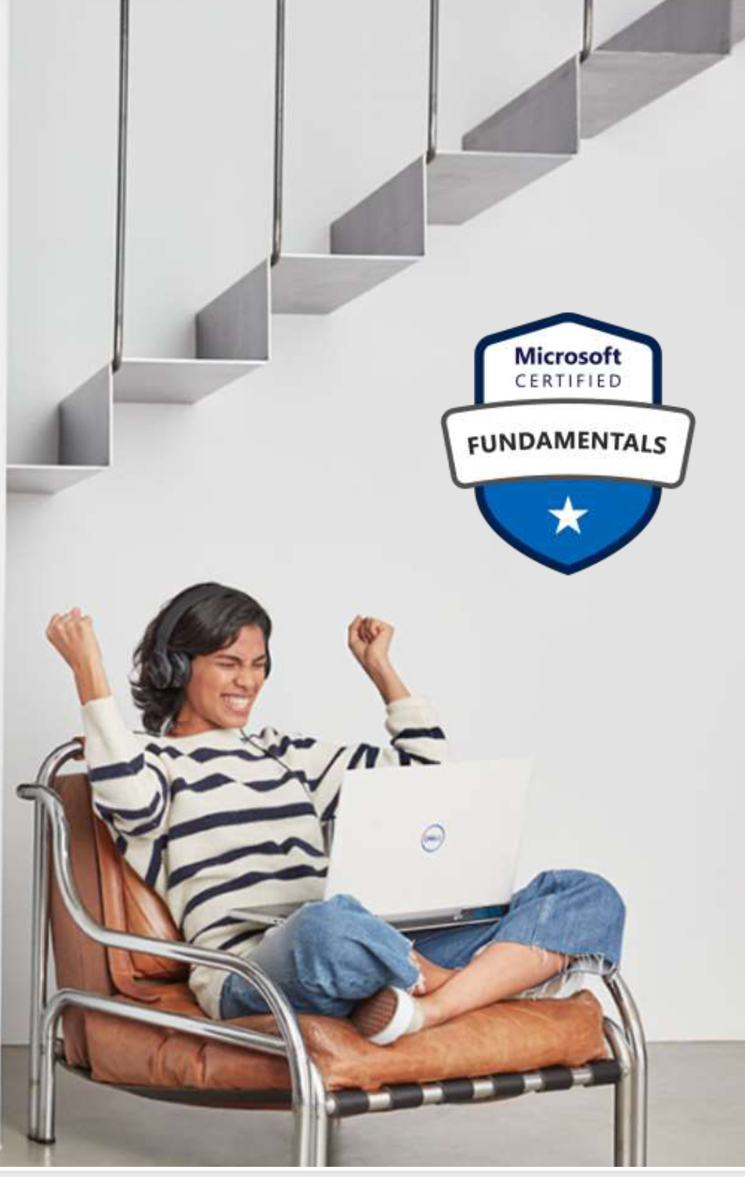
Free Microsoft Fundamental Certification Training & Exams!
Free exam voucher
Free Measure-Up Practice Test
Free Azure for Students Voucher $100 credit
On demand Webinars for the 3 most popular; AZ-900,
AI-900 and SC-900
Info Page:
https://aka.ms/FreeStudentFundamentals
Reg Page:
https://aka.ms/MicrosoftCerts4Students
Flyer:
https://aka.ms/studentcertifications
Notes:
We want to help you get these certs and gain that edge so we have recently launched a FREE fundamentals offer that any student can access- you can sit any of the 8 fundamentals for free- this includes access to practice tests and an Azure for students voucher worth 100$ and its a global offer, but for Students studying in the UK
you also get access to on-demand webinars for three of the most popular courses- AI, AZ & SC-900. You also get supported through the process with emails of encouragement and our FAQ bot to answer your queries… So whats stopping you? Register today. All the links you need are at the bottom of the page!

Slide 9
Round-Up…
Microsoft Learn https://docs.microsoft.com/en-us/learn/
Microsoft Certifications Increase Employability
Free Fundamental Certifications https://aka.ms/MicrosoftCerts4Students
https://aka.ms/FreeStudentFundamentals
Until 30th June: https://aka.ms/SkillForward21
Cloud Skills Challenge https://aka.ms/StudentDeveloperDayChallenge
Thanks for Listening!
Notes:
So to round up…
Microsoft Learn Platform is a great resource to learn new digital skills- its free and you can use it for general info or as a tool to prepare for a Microsoft certification exam.
Having a Microsoft certification has many benefits, such as increased confidence and employability
We currently have a free campaign to help you acquire those in-demand digital skills through our free fundamentals programme- you can sign up today!
And just a few days ago we launched an extra time limited campaign where you can get access to free exams, practice tests and webinars for 5 of the fundamentals until the 30th of June only!
Feel free to come over and see me at the certs stand for more information!

